Slide 1


Mepco Schlenk Engineering College (Autonomous)
19CS694 – WEB USER INTERFACE DESIGN
LEARNING MANAGEMENT SYSTEM(LMS)
MUTHUKUMARASAMY.S(Reg. No. :202104088)
RAGAVAMATHAVAN.T (Reg. No. : 202104110)
Department of Computer Science and Engineering
1

Slide 2
Mepco Schlenk Engineering College (Autonomous)
Problem Description:
The purpose of the Learning management system is to allow the Staffs to upload files and post messages to the list of students by creating the group for them. Staffs can also be able to assign quizzes for the list of students and display the mark for them instantly. Students can be able to download the files and attend quizzes and view the messages posted by different staffs to them.
This LMS makes an easier interaction between staffs and students which let them towards online education in an successful manner.
24 April 2024
Department of Computer Science and Engineering
2

Slide 3
Mepco Schlenk Engineering College (Autonomous)
Objective:
The main objective of this system is:
To allow easier communication between staffs and students.
To make the way of education in different manner.
24 April 2024
Department of Computer Science and Engineering
3

Slide 4
Mepco Schlenk Engineering College (Autonomous)
OUTCOME:
The outcome of the Learning Management system which uses Angular and MongoDB would help
To upload the materials by staff to students.
Efficient Quiz Creation and Mark Calculation.
Efficient Communication of messages between staff and students.
24 April 2024
Department of Computer Science and Engineering
4

Slide 5
Mepco Schlenk Engineering College (Autonomous)
ARCHITECTURE DESIGN:
An architectural diagram implies the flow of the system. The flow starts whether the user has an account or not. If the user had an account, it directly takes to the login page and after he logged into the system, it enables the staffs to create a group by adding the students who have already enrolled in the application. After Creating a group , The staffs can be able to post messages and Materials to the students ,which can be accessible by the students after logged in to the system.
Department of Computer Science and Engineering
5

Slide 6
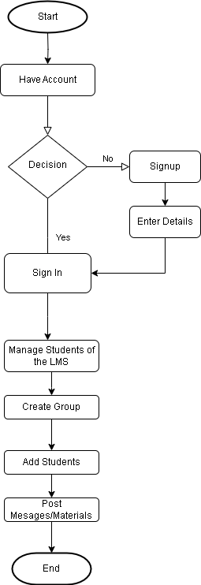
Mepco Schlenk Engineering College (Autonomous)
24 April 2024
Department of Computer Science and Engineering
6

Slide 7
Mepco Schlenk Engineering College (Autonomous)
Modules:
Listed below gives a description of database document schemas used for the Learning Management System.
Students Description
Staff Description
Message Description
Group Description
File Description
24 April 2024
Department of Computer Science and Engineering
7

Slide 8
Mepco Schlenk Engineering College (Autonomous)
STUDENT STRUCTURE:
Attribute Name | Type | Constraint(s) | Description
Name | String | Not null | Name of the user
Email id | String | Should contain @symbol | Email id of the user
Password | String | Not null | Password for the sign up
Ph No | String | Not null | Phone Number of the user
The Student description has the attributes such as the name, Email Id, password, Phone Number.
24 April 2024
Department of Computer Science and Engineering
8

Slide 9
Mepco Schlenk Engineering College (Autonomous)
STAFF STRUCTURE:
Attribute Name | Type | Constraint(s) | Description
name | String | Not null | Name of the staff
email | String | Should contain @symbol | Staff email id
role | String | Not null | Designation of the Staff
Ph no | integer | Maximum length of 10 | Phone number of the Staff
The Staff structure has the description required for the user and has the attributes such as the name, email , role and phone Number.
24 April 2024
Department of Computer Science and Engineering
9

Slide 10
Mepco Schlenk Engineering College (Autonomous)
MESSAGE STRUCTURE:
Attribute Name | Type | Constraint(s) | Description
Staff name | String | Not null | Name of the Staff
Timestamp | integer | Follow the format dd/mm/yyyy hh:mm:ss | Time and date of Message
User name | String | Not null | Name of the User
Message | String | Not null | Message for the user
The Message structure has the attributes such as the StaffName , TimeStamp, Username and the Message to be delivered to the students that is sent by the Staff.
24 April 2024
Department of Computer Science and Engineering
10

Slide 11
Mepco Schlenk Engineering College (Autonomous)
GROUP STRUCTURE:
Attribute Name | Type | Constraint(s) | Description
Email | String | Should contain @symbol | Email of the staff who created the group
Gname | String | Not null | Name of the group
The Group structure has the attributes such as the EMail, GroupName, that is created by the staff. They can select the student’s details for creating the group.
24 April 2024
Department of Computer Science and Engineering
11

Slide 12
Mepco Schlenk Engineering College (Autonomous)
FILE STRUCTURE:
Attribute Name | Type | Constraint(s) | Description
length | integer | Not null | Length of the uploaded file
chunkSize | integer | Length of the file uploaded | Chunksize of the uploaded file
uploadDate | integer | It will be in the format yyyy/mm/dd | Date of the file when it is uploaded
filename | integer | Not null | Name of the file uploaded
The File structure has the attributes such as the Length of the file , chunkSize of the File, Date at when the file has been uploaded and the Filename to be uploaded to the students.
24 April 2024
Department of Computer Science and Engineering
12

Slide 13
Mepco Schlenk Engineering College (Autonomous)
LOW LEVEL DESIGN
SIGNUP Details:
Files used | signup.component.html, signup.component.css, signup.component.ts
Short Description | Allows the user to register to the application
Arguments | Name, Email id, Password, Ph No
Return | Success/Failure in registering
Pre-Condition | The user must have an email account
Post-Condition | The home page will be displayed
Exception | Invalid email id and password
Actor | Staff , Student
24 April 2024
Department of Computer Science and Engineering
13

Slide 14
Mepco Schlenk Engineering College (Autonomous)
LOGIN DETAILS:
Files used | Login.component.html, login.component.css, login.component.ts
Short Description | Allows the user to login to the application
Arguments | Email id, Password
Return | Success/Failure in login
Pre-Condition | The user must have an account
Post-Condition | The home page will be displayed
Exception | Invalid email id and password
Actor | Staff, Student
24 April 2024
Department of Computer Science and Engineering
14

Slide 15
Mepco Schlenk Engineering College (Autonomous)
MESSAGE DETAILS:
Files used | msg.component.html, msg.component.css, msg.component.ts
Short Description | Allows the staff to send messages to the stuents
Arguments | Email , Date , Time
Return | Success/Failure in sending message
Pre-Condition | The user should be aware of website
Post-Condition | The home page will be displayed
Exception | nill
Actor | Staff
24 April 2024
Department of Computer Science and Engineering
15

Slide 16
Mepco Schlenk Engineering College (Autonomous)
GROUP DETAILS:
Files used | group.component.html,group.component.css,group.component.ts
Short Description | Allows the staffs to staffs to create various group by adding students
Arguments | Group name, staff email, message
Return | Success/Failure in Group Creation
Pre-Condition | The user should be aware of website
Post-Condition | The home page will be displayed
Exception | Nil
Actor | Staff
24 April 2024
Department of Computer Science and Engineering
16

Slide 17
Mepco Schlenk Engineering College (Autonomous)
FILE DETAILS:
Files used | file.component.html,file.component.css,file.component.ts
Short Description | Allows the staffs to upload the files in the database which can be downloaded by students
Arguments | Group name, staff email, File Document
Return | Success/Failure in file submission
Pre-Condition | The user should be aware of website
Post-Condition | The file will be uploaded
Exception | Nil
Actor | Staff
24 April 2024
Department of Computer Science and Engineering
17

Slide 18
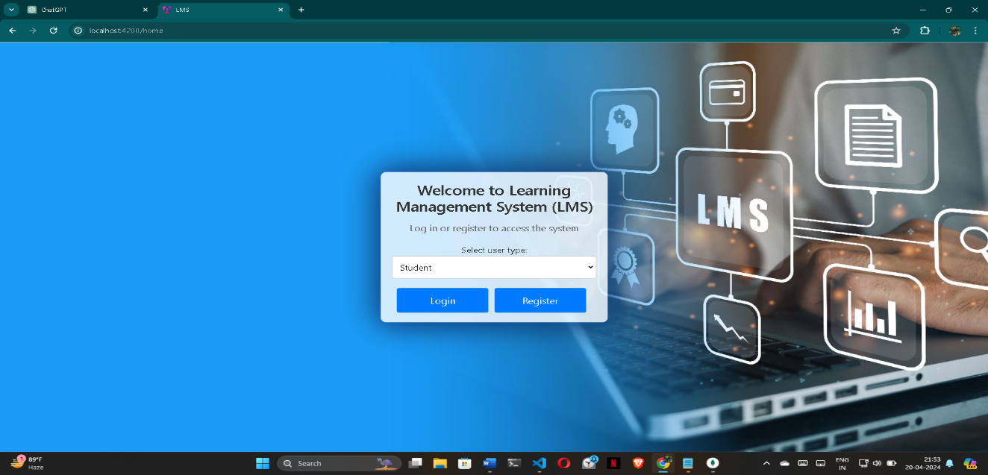
Mepco Schlenk Engineering College (Autonomous)
Home Page
This is the home page of the learning management system . This will have options like selecting which type of user you are and allows you to login in to the system or you can register through it.
24 April 2024
Department of Computer Science and Engineering
18

Slide 19
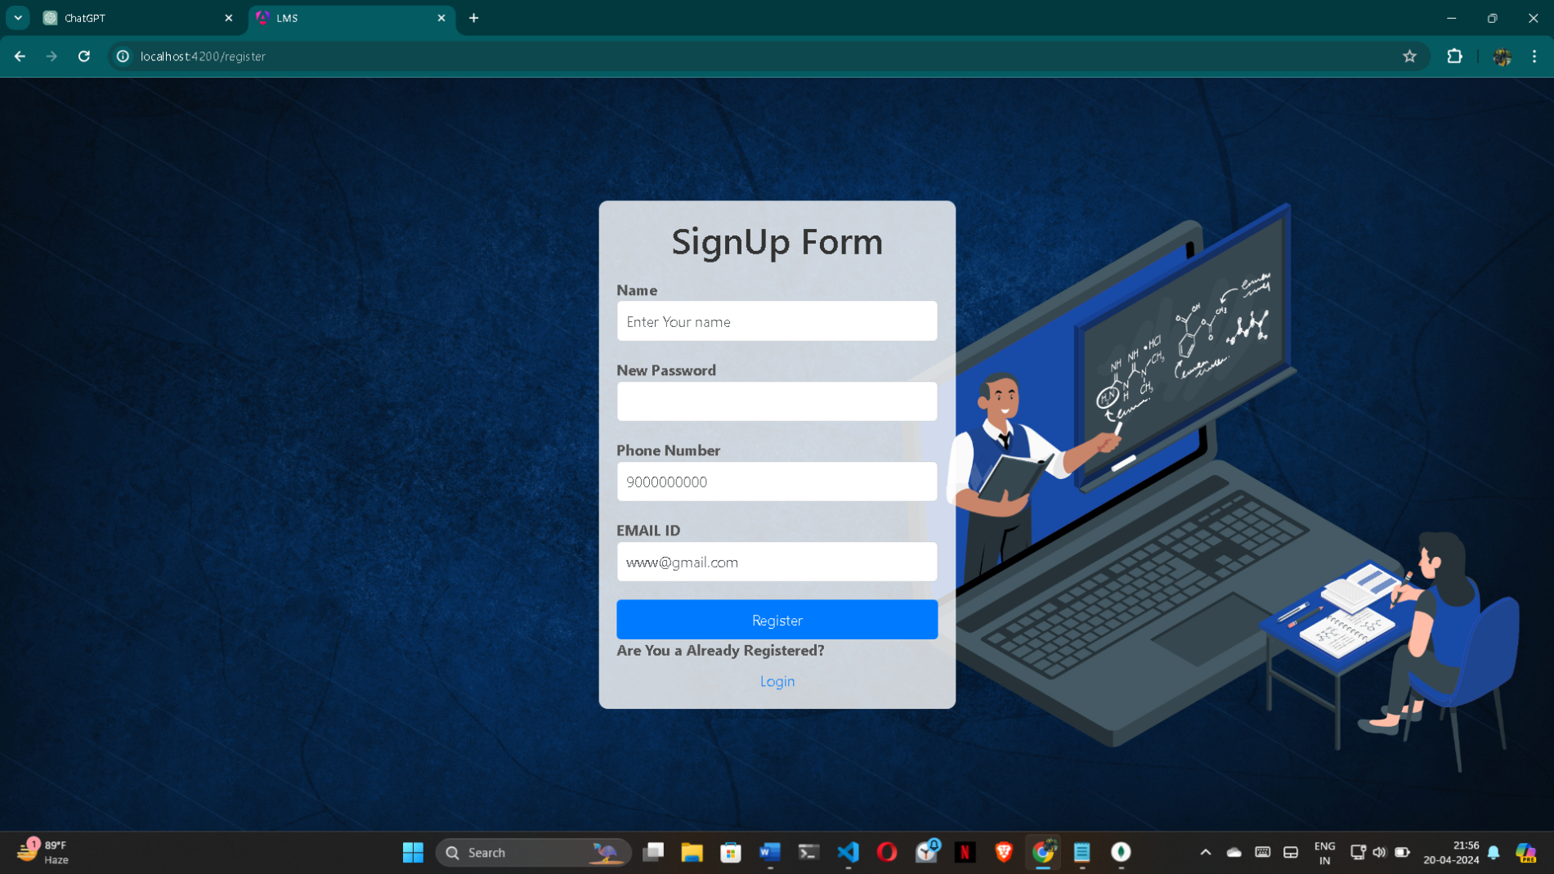
Mepco Schlenk Engineering College (Autonomous)
RESULTS:
SignUp Page
24 April 2024
Department of Computer Science and Engineering
19

Slide 20
Mepco Schlenk Engineering College (Autonomous)
This shows the Signup Page provide the interface for SignUp page of Learning Management System. The users who are willing to use the application must get themselves registered in the system. The user must provide the name, password, phone number and the mail id for the registration. The email id must be a valid email id. The password and the confirm password must be the same. Now after clicking the signup button the user gets registered in the system.
24 April 2024
Department of Computer Science and Engineering
20

Slide 21
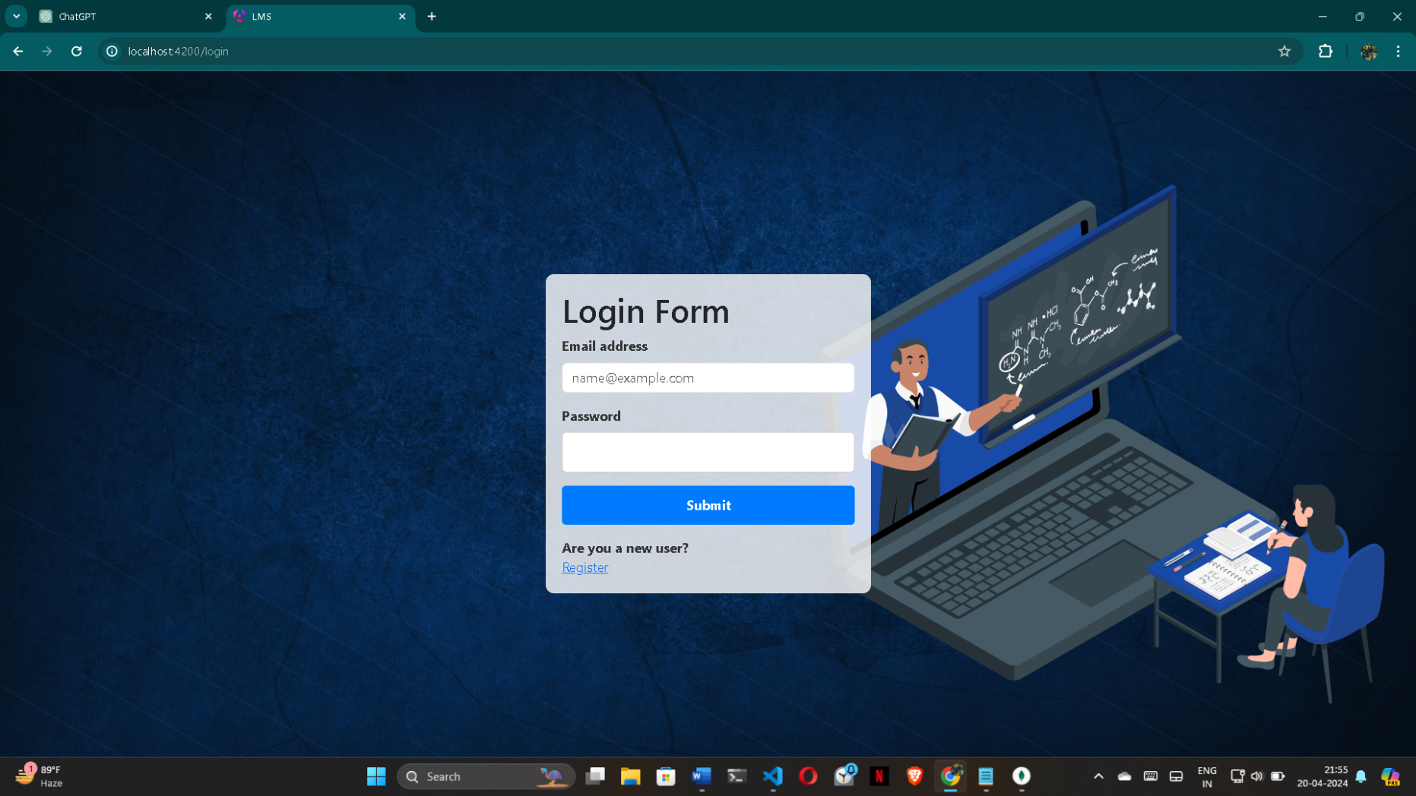
Mepco Schlenk Engineering College (Autonomous)
Login page
24 April 2024
Department of Computer Science and Engineering
21

Slide 22
Mepco Schlenk Engineering College (Autonomous)
Login Page provide the interface for Login Learning Management System. This interface provides the registered user to enter into their home page. If the username and the password is correct then the user is allowed to enter into their home page. If the username and the password does not match then the error message of invalid user gets displayed. When the username and the password match with the database then the dashboard of the admin is displayed.
24 April 2024
Department of Computer Science and Engineering
22

Slide 23
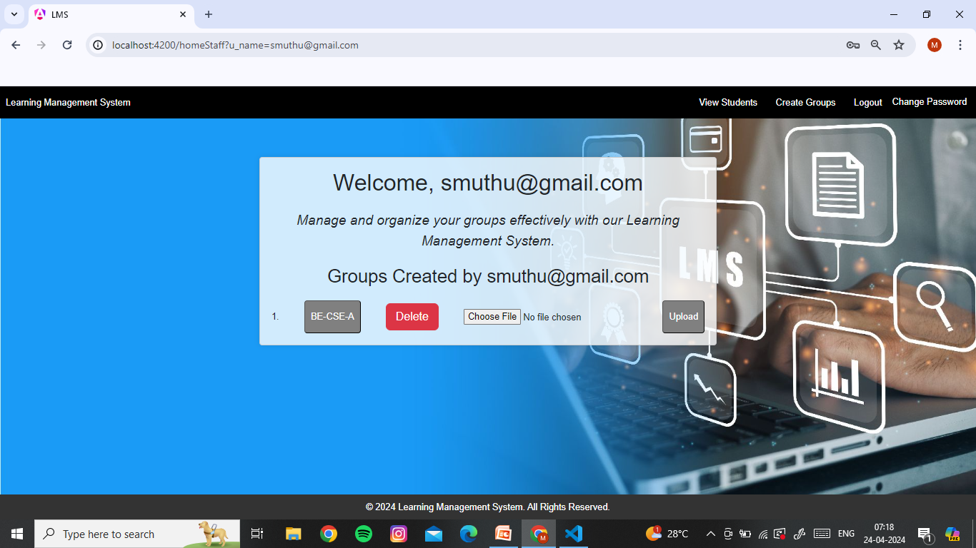
Mepco Schlenk Engineering College (Autonomous)
Staff Home page
24 April 2024
Department of Computer Science and Engineering
23

Slide 24
Mepco Schlenk Engineering College (Autonomous)
Staff home page provides the interface for Staff. The staff is navigated to this page when the username and the password matches with the staff. The staff dashboard has the options such as the View students, Create group, Remove Group and Update password. The staff has the all those functionalities. Initially when the staff is logged in the dashboard with the group and student information is displayed. The students who all are in the group will be viewed here in each groups and staffs can also able to post quiz and messages.
24 April 2024
Department of Computer Science and Engineering
24

Slide 25
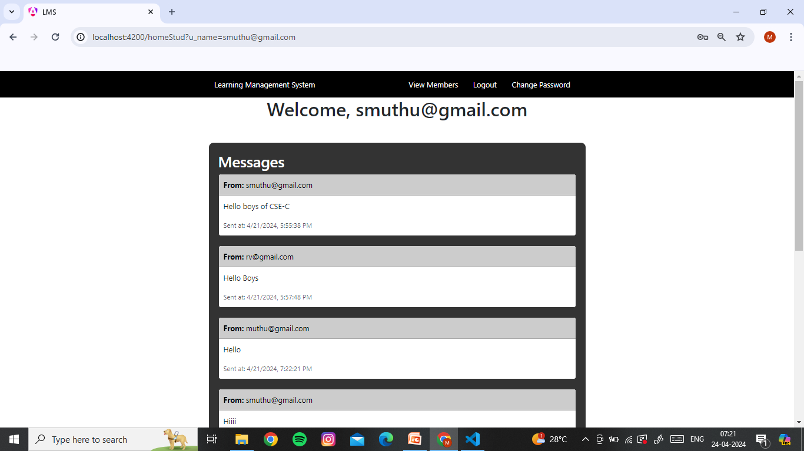
Mepco Schlenk Engineering College (Autonomous)
Message page
24 April 2024
Department of Computer Science and Engineering
25

Slide 26
Mepco Schlenk Engineering College (Autonomous)
Message page provides the interface for viewing messages from the staff. Each student can access this page. The staff can directly post messages to the groups. The message comes with the details like which staff has send this and at which time along with the date. Staff can be also able to send attachments like pdf, ppt, etc.. to the students through message , where the students can be able to download those materials and use it for their own purpose.
24 April 2024
Department of Computer Science and Engineering
26

Slide 27
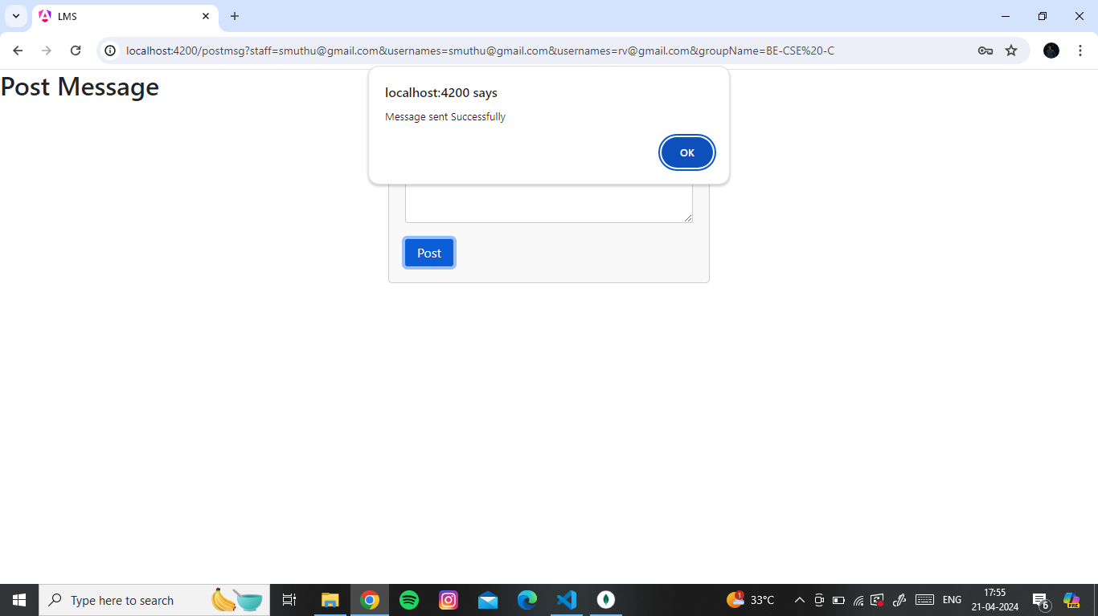
Mepco Schlenk Engineering College (Autonomous)
Post Message Page
24 April 2024
Department of Computer Science and Engineering
27

Slide 28
Mepco Schlenk Engineering College (Autonomous)
Post message is navigated when the staff wants to post any messages to the groups. The message will be send to all the students in the group along with the staff email. The students can view the message in their respective dashboard. This will be very helpful for announcing information to the students .
24 April 2024
Department of Computer Science and Engineering
28

Slide 29
Mepco Schlenk Engineering College (Autonomous)
Remove group page
24 April 2024
Department of Computer Science and Engineering
29

Slide 30
Mepco Schlenk Engineering College (Autonomous)
Remove group page is used for deleting groups from the staff dashboard.
This allows staff to delete a particular group. When the group is deleted, the corresponding students will be automatically removed from the group. However the past Materials posted will be available as it is, to the students.
24 April 2024
Department of Computer Science and Engineering
30

Slide 31
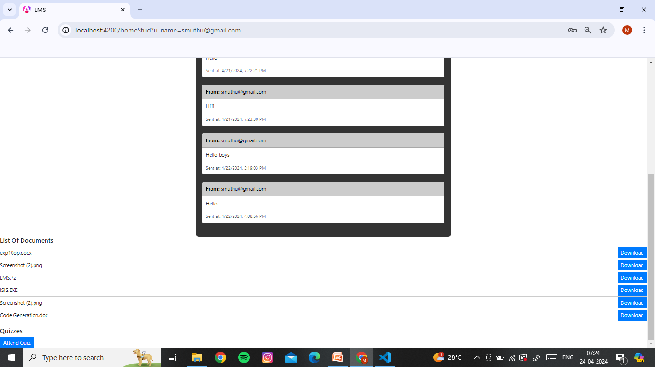
Mepco Schlenk Engineering College (Autonomous)
Student home page
24 April 2024
Department of Computer Science and Engineering
31

Slide 32
Mepco Schlenk Engineering College (Autonomous)
Once the students get logged in successfully then the students will get redirected to this page. Here students will be able to see the messages posted by the staffs. Students can also able to download the attachments send by the staffs. Students can also view their friends list in interface by using view students option. Students can also attend quizzes which is organized by the staffs and can see their marks after submitting their answers along with their percentage.
24 April 2024
Department of Computer Science and Engineering
32

Slide 33
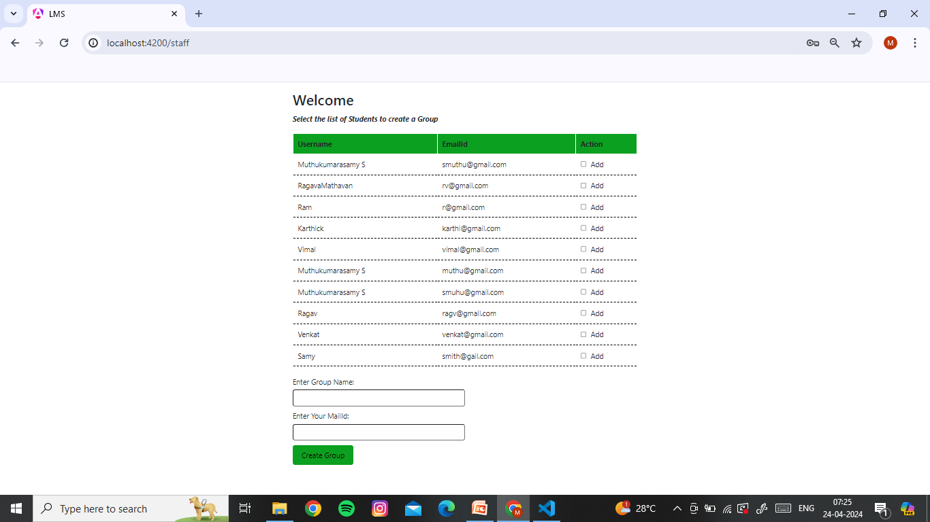
Mepco Schlenk Engineering College (Autonomous)
Group creation page
24 April 2024
Department of Computer Science and Engineering
33

Slide 34
Mepco Schlenk Engineering College (Autonomous)
Group creation page allows the staffs to create a new group by giving it a new name and adding students to it. Staff also need to give their email id while the creation of the group. Staff can be able to add more students into the group and announce any information to the students by message. They can also send attachments in the group.
24 April 2024
Department of Computer Science and Engineering
34

Slide 35
Mepco Schlenk Engineering College (Autonomous)
CONCLUSION AND FURTHER ENHANCEMENTS
In conclusion, our Learning Management System (LMS) project has laid the foundation for a user-friendly platform that facilitates online learning activities for students, educators. Moving forward, we envision several enhancements to further improve the system's functionality and user experience. One key area for enhancement is advanced user tracking through analytics tools, enabling personalized learning support and course recommendations based on individual progress and learning patterns. Integration of multimedia content, such as videos, simulations, and interactive exercises, will enhance the learning experience and engagement levels.
24 April 2024
Department of Computer Science and Engineering
35

Slide 36
Mepco Schlenk Engineering College (Autonomous)
THANK YOU
24 April 2024
Department of Computer Science and Engineering
36

